Slide 1
Game programming
Lecture 3: Screen Space Ambient Occlusion..
By Dr. Rokia Abdein

Slide 2
Graphics Processors
An application communicates with the GPU by sending commands to a rendering library, such as OpenGL, which in turn sends commands to a driver that knows how to speak to the GPU in its native language.
A 3D graphics board has its own memory core, which is commonly called VRAM (Video Random Access Memory). The GPU may store any information in VRAM, but there are several types of data that can almost always be found in the graphics board’s memory when a 3D graphics application is running.

Slide 3
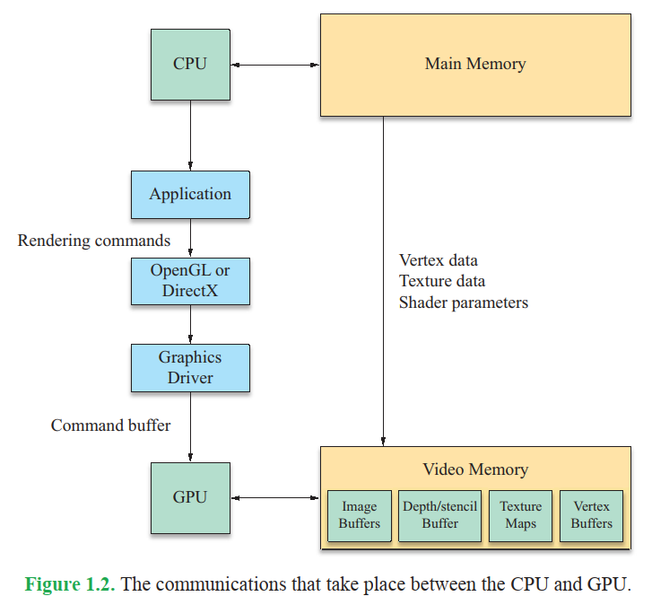

Slide 4
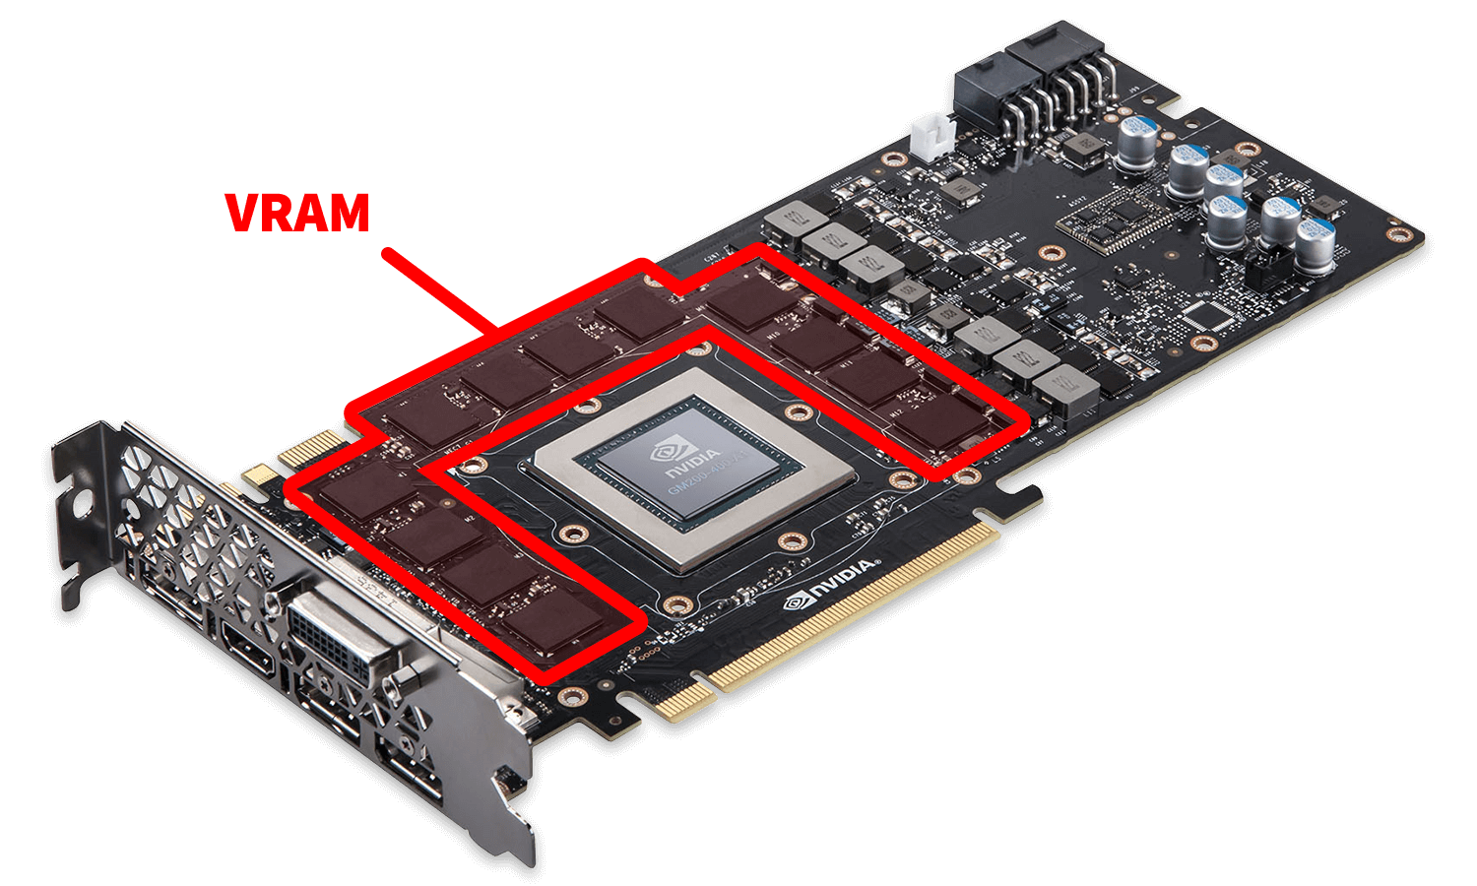
VRAM (Video Random Access Memory)

Slide 5
VRAM (Video Random Access Memory)
VRAM is dedicated, high-speed memory used by a computer's GPU. It temporarily stores data for the GPU to access, including textures, shaders, and the frame buffer. VRAM is connected directly to the GPU on the graphics card, which allows the GPU to access VRAM at higher speeds and with less latency than system RAM; however, being integrated means that VRAM cannot be upgraded without replacing the entire graphics card.

Slide 6
Graphics Processors
The GPU may store any information in VRAM, but there are several types of data that can almost always be found in the graphics board’s memory when a 3D graphics application is running. Most importantly, VRAM contains the front and back image buffers. The front image buffer contains the exact pixel data that is visible in the viewport.
The viewport is the area of the display containing the rendered image and may be a subregion of a window, the entire contents of a window, or the full area of the display.
back image buffer is the location to which the GPU actually renders a scene. The back buffer is not visible and exists so that a scene can be rendered in its entirety before being shown to the user.
Notes:
A viewport represents a polygonal (normally rectangular) area in computer graphics that is currently being viewed.

Slide 7
Graphics Processors
Once an image has been completely rendered, the front and back image buffers are exchanged. This operation is called a buffer swap and can be performed either by changing the memory address that represents the base of the visible image buffer or by copying the contents of the back image buffer to the front image buffer.
The buffer swap is often synchronized with the refresh frequency of the display to avoid an artifact known as tearing. Tearing occurs when a buffer swap is performed during the display refresh interval, causing the upper and lower parts of a viewport to show data from different image buffers.

Slide 8
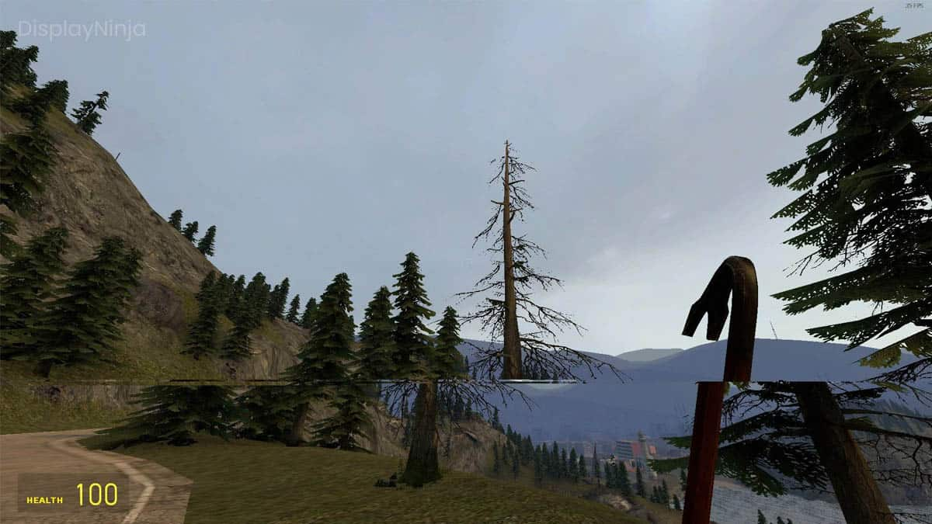

Slide 9
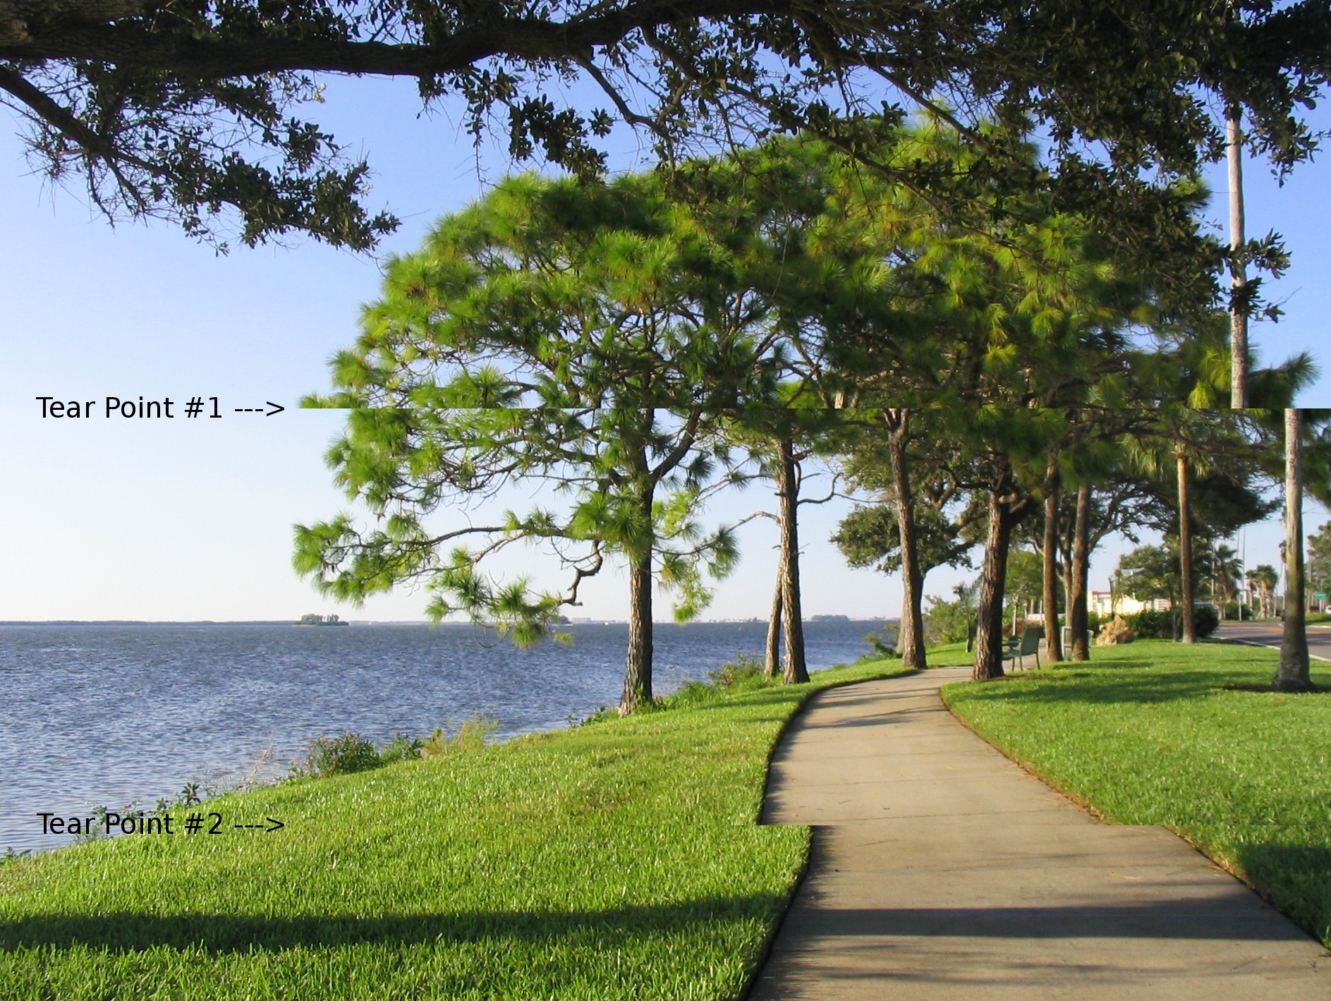

Slide 10
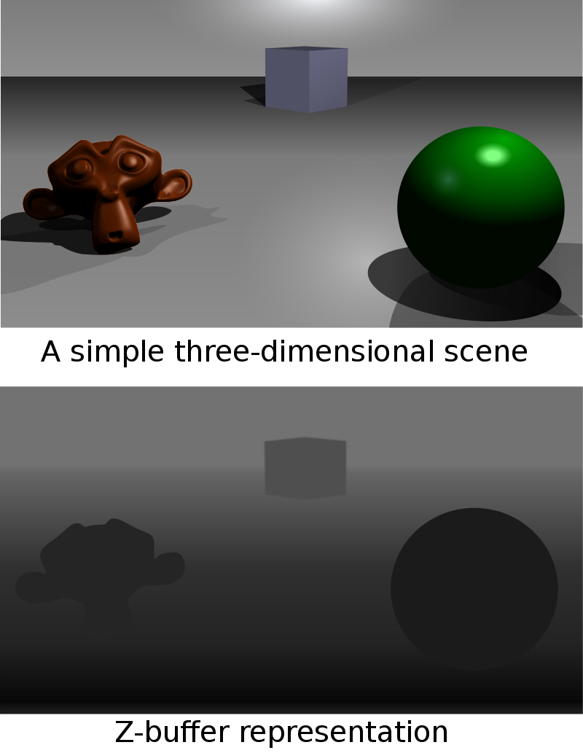
Graphics Processors
Also stored in VRAM is a block of data called the depth buffer or z-buffer. The depth buffer stores, for every pixel in the image buffer, a value that represents how far away the pixel is or how deep the pixel lies in the image.
The depth buffer is used to perform hidden surface elimination by only allowing a pixel to be drawn if its depth is less than the depth of the pixel already in the image buffer.

Slide 11
Graphics Processors
Depth is measured as the distance from the virtual camera through which we observe the scene being rendered.
The name z-buffer comes from the convention that the z axis points directly out of the display screen in the camera’s local coordinate system.

Slide 12
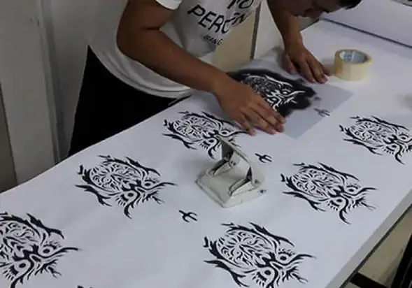
Graphics Processors
An application may request that a stencil buffer be created along with the image buffers and the depth buffer. The stencil buffer contains an integer mask for each pixel in the image buffer that can be used to enable or disable drawing on a per-pixel basis using stencil test.

Slide 13
Graphics Processors
For the vast majority of 3D rendering applications, the usage of VRAM is dominated by texture maps. Texture maps are images that are applied to the surface of an object to give it greater visual detail. In advanced rendering applications, texture maps may contain information other than a simple pixel image.
For instance, a bump map contains vectors that represent varying slopes at different locations on an object’s surface.

Slide 14
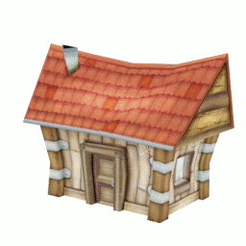
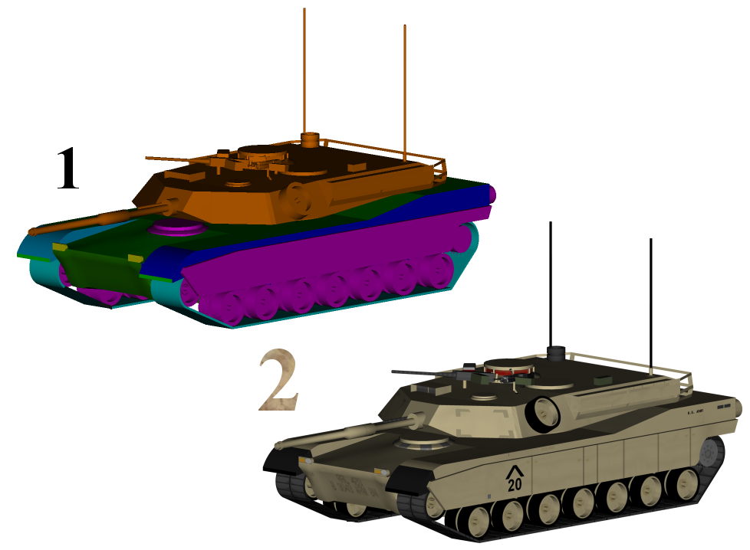
Mapping a two-dimensional texture onto a 3D model
1: 3D model without textures 2: Same model with textures

Slide 15
Graphics Processors
Bump mapping is a texture mapping technique in computer graphics for simulating bumps and wrinkles on the surface of an object without increasing the render time. This is achieved by perturbing the surface normals of the object and using the perturbed normal during lighting calculations. The result is an apparently bumpy surface rather than a smooth surface, although the surface of the underlying object is not changed.
A normal is the direction that a surface is facing

Slide 16
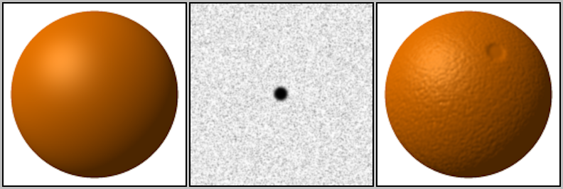
A sphere without bump mapping (left). A bump map to be applied to the sphere (middle). The sphere with the bump map applied (right) appears to have a mottled surface resembling an orange. Bump maps achieve this effect by changing how an illuminated surface reacts to light, without modifying the size or shape of the surface.

Slide 17
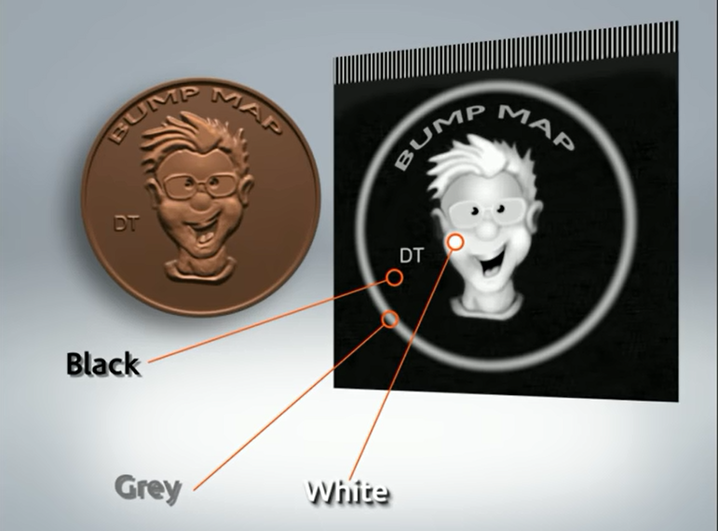
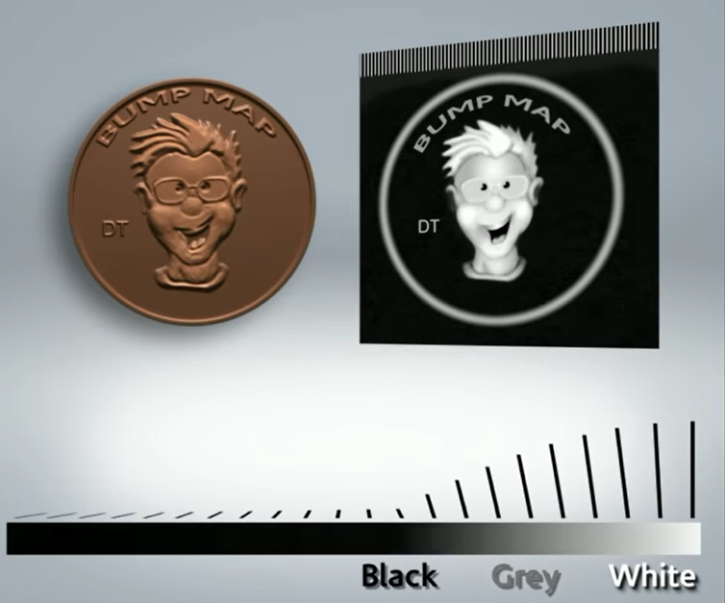

Slide 18
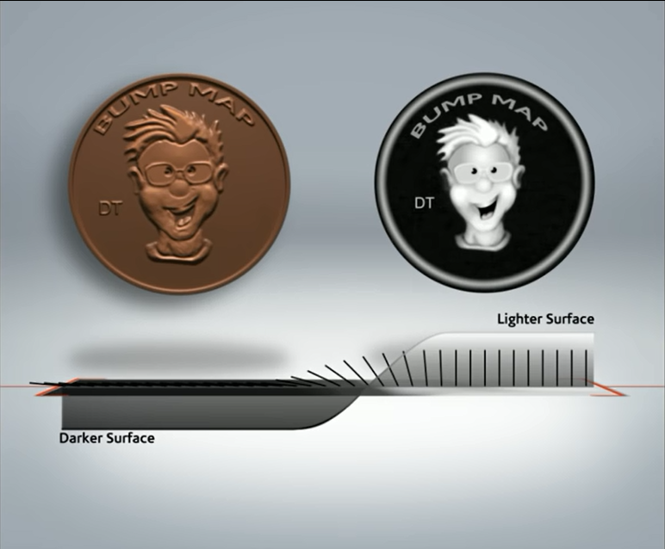

Slide 19
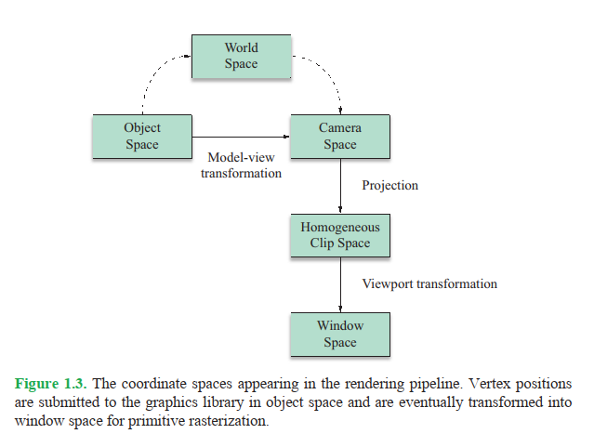
Vertex Transformation
Geometrical data is passed to the graphics hardware in the context of a three dimensional space. One of the jobs performed by the graphics hardware is to transform this data into geometry that can be drawn into a two-dimensional viewport. There are several different coordinate systems associated with the rendering pipeline—their relationships are shown in Figure 1.3.

Slide 20
Vertex Transformation
The vertices of a model are typically stored in object space, a coordinate system that is local to the particular model and used only by that model.
The position and orientation of each model are often stored in world space, a global coordinate system that ties all of the object spaces together.
Before an object can be rendered, its vertices must be transformed into camera space (also called eye space), the space in which the x and y axes are aligned to the display and the z axis is parallel to the viewing direction.

Slide 21
Vertex Transformation
It is possible to transform vertices from object space directly into camera space by concatenating the matrices representing the transformations from object space to world space and from world space to camera space. The product of these transformations is called the model-view transformation.

Slide 22
Vertex Transformation
Once a model’s vertices have been transformed into camera space, they undergo a projection transformation that has the effect of applying perspective so that geometry becomes smaller as the distance from the camera increases.
The projection is performed in four dimensional homogeneous coordinates, and the space in which the vertices exist after projection is called homogeneous clip space.
Homogeneous clip space is so named because it is in this space that graphics primitives are clipped to the boundaries of the visible region of the scene, ensuring that no attempt is made to render any part of a primitive that falls outside the viewport.

Slide 23
Vertex Transformation
In homogeneous clip space, vertices have normalized device coordinates. The term normalized pertains to the fact that the x, y, and z coordinates of each vertex fall in the range [-1,1], but reflect the final positions in which they will appear in the viewport.
The vertices must undergo one more transformation, called the viewport transformation, that maps the normalized coordinates to the actual range of pixel coordinates covered by the viewport. The z coordinate is usually mapped to the floating-point range [0,1], but this is subsequently scaled to the integer range corresponding to the number of bits per pixel utilized by the depth buffer. After the viewport transformation, vertex positions are said to lie in window space.

Slide 24
Vertex Transformation
A graphics processor usually performs several per-vertex calculations in addition to the transformation from object space to window space. For instance, the OpenGL lighting model determines the color and intensity of light reaching each vertex and then calculates how much of that is reflected toward the camera. This process is called per-vertex lighting.
Each vertex may also carry with it one or more sets of texture coordinates. Texture coordinates may be explicitly specified by an application or automatically generated by the GPU. When a graphics primitive is rendered, the texture coordinates are interpolated over the area of the primitive and used to look up colors in a texture map. These colors are then combined with other interpolated data at each pixel to determine the final color that appears in the viewport.

Slide 25
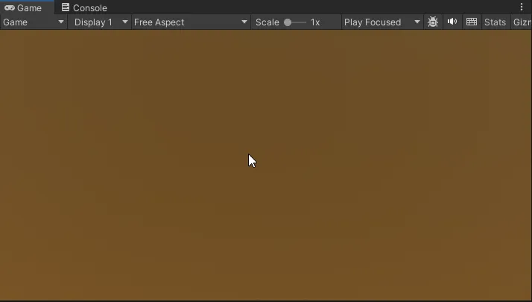
Screen space and world space..
To start, Screen Space is defined with only X and Y coordinates. It’s the plane from the camera’s perspective and is a 2D vector because it’s calculating the X and Y coordinates as the actual pixel width and height of the screen. Your mouse or touch inputs operate in Screen Space.

Slide 26
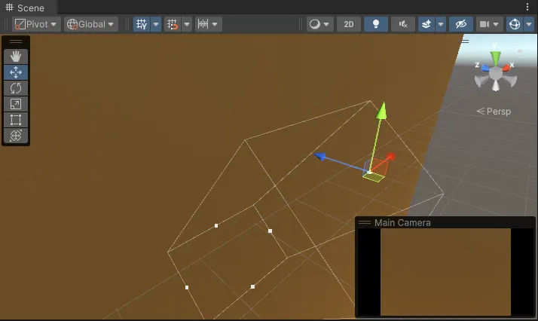
Screen space and world space..
World Space defines as a Vector3 because it’s the actual 3D environment in which your objects live. Not just the camera’s perspective. Your game objects live in World Space.
Screen Space as Unity’s Game window, and World Space as the Scene window in which you are actually building in.

Slide 27
Rasterization and Fragment Operations
Once a model’s vertices have been clipped and transformed into window space, the GPU must determine what pixels in the viewport are covered by each graphics primitive.
The process of filling in the horizontal spans of pixels belonging to a primitive is called rasterization.
The GPU calculates the depth, interpolated vertex colors, and interpolated texture coordinates for each pixel. This information, combined with the location of the pixel itself, is called a fragment.

Slide 28
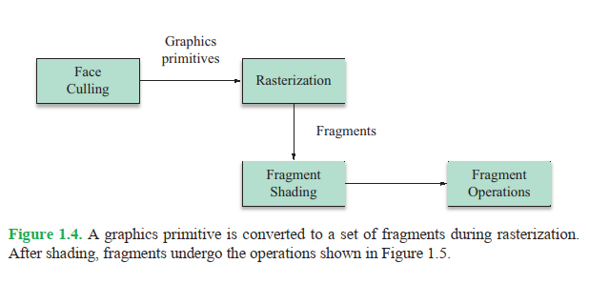
Rasterization and Fragment Operations
The process through which a graphics primitive is converted to a set of fragments is illustrated in Figure 1.4. An application may specify that face culling be performed as the first stage of this process. Face culling applies only to polygonal graphics primitives and removes either the polygons that are facing away from the camera or those that are facing toward the camera. Ordinarily, face culling is employed as an optimization that skips polygons facing away from the camera (backfacing polygons) since they correspond to the unseen far side of a model.

Slide 29
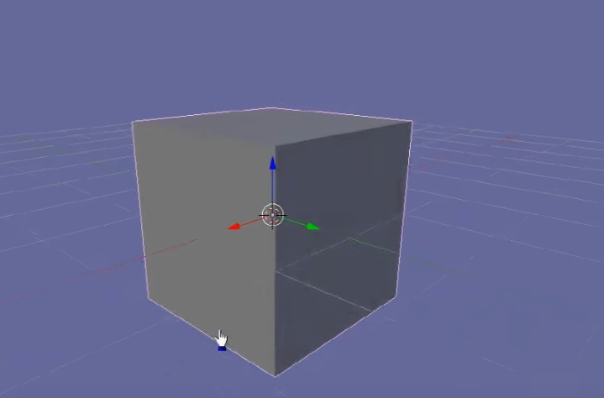

Slide 30
Rasterization and Fragment Operations
A graphics application specifies how the fragment data is used to determine the final color and final depth of each pixel during rasterization. This process is called fragment shading or pixel shading.
Figure 1.5 illustrates the operations performed for each fragment generated during rasterization. Most of these operations determine whether a fragment should be drawn to the viewport or discarded altogether. Although these operations occur logically after fragment shading, most GPUs perform as many tests as possible before performing fragment shading calculations to avoid spending time figuring out the colors of fragments that will ultimately be discarded.

Slide 31
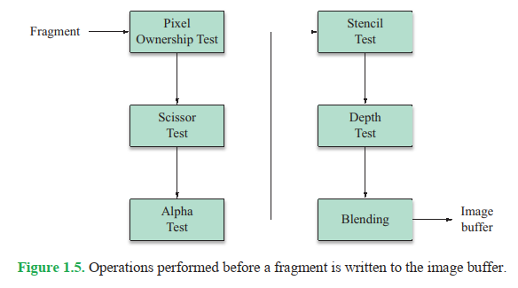
Rasterization and Fragment Operations

Slide 32
Rasterization and Fragment Operations
The first fragment operation performed, and the only one that cannot be disabled, is the pixel ownership test. The pixel ownership test simply determines whether a fragment lies in the region of the viewport that is currently visible on the display. A possible reason that the pixel ownership test fails is that another window is obscuring a portion of the viewport. In this case, fragments falling behind the obscuring window are not drawn.
Next, the scissor test is performed. An application may specify a rectangle in the viewport, called the scissor rectangle, to which rendering should be restricted. Any fragments falling outside the scissor rectangle are discarded.

Slide 33
Rasterization and Fragment Operations
If the scissor test passes, a fragment undergoes the alpha test. When the final color of a fragment is calculated, an application may also calculate an alpha value that usually represents the degree of transparency associated with the fragment.
The alpha test compares the final alpha value of a fragment to a constant value that is preset by the application. The application specifies what relationship between the two values (such as less than, greater than, or equal to) causes the test to pass. If the relationship is not satisfied, then the fragment is discarded.

Slide 34
Rasterization and Fragment Operations
After the alpha test passes, a fragment moves on to the stencil test. The stencil test reads the value stored in the stencil buffer at a fragment’s location and compares it to a value previously specified by the application. The stencil test passes only if a specific relationship is satisfied (e.g., the stencil value is equal to a particular value); otherwise, the stencil test fails, and the fragment is discarded.
An application is able to specify actions to be taken in the stencil buffer when the stencil test passes or fails. Additionally, if the stencil test passes, the value in the stencil buffer may be affected in a way that depends on the result of the depth test (described next). For instance, an application may choose to increment the value in the stencil buffer if the stencil test passes and the depth test fails.

Slide 35
Rasterization and Fragment Operations
The final test undergone by a fragment is the depth test. The depth test compares the final depth associated with a fragment to the value currently residing in the depth buffer. If the fragment’s depth does not satisfy an application-specified relationship with the value in the depth buffer, then the fragment is discarded.
Normally, the depth test is configured so that a fragment passes the depth test only if its depth is less than or equal to the value in the depth buffer. When the depth test passes, the depth buffer is updated with the depth of the fragment to facilitate hidden surface removal for subsequently rendered primitives.

Slide 36
Rasterization and Fragment Operations
Once the pixel ownership test, scissor test, alpha test, stencil test, and depth test have all passed, a fragment’s final color is blended into the image buffer. The blending operation calculates a new color by combining the fragment’s final color and the color already stored in the image buffer at the fragment’s location. The fragment’s alpha value and the alpha value stored in the image buffer may also be used to determine the color that ultimately appears in the viewport.
The blending operation may be configured to simply replace the previous color in the image buffer, or it may produce special visual effects such as transparency.

Slide 37
Unity physics..
The Unity Physics Engine enables objects to approximate universal forces in nature such as gravity, velocity, acceleration, and friction. It allows for a wide range of objects with various physical properties to interact with other objects in a scene dynamically.

Slide 38
What Is Ambient Occlusion?
Two types of lighting:
Direct lighting in modern video games is a well-understood concept
Indirect lighting (also referred to as global illumination)
Moreover, although some simulation of indirect lighting is possible in real time, full simulation of all its effects in real time is very challenging, even on the latest hardware.
One possible simplification is to focus on the visual effects of global illumination instead of the physical process and furthermore to aim at a particular subset of effects that global illumination achieves.
Ambient occlusion is one such subset that simplifies the problem space by assuming all indirect light is equally distributed throughout the scene. With this assumption, the amount of indirect light hitting a point on a surface will be directly proportional to how much that point is exposed to the scene around it.

Slide 39
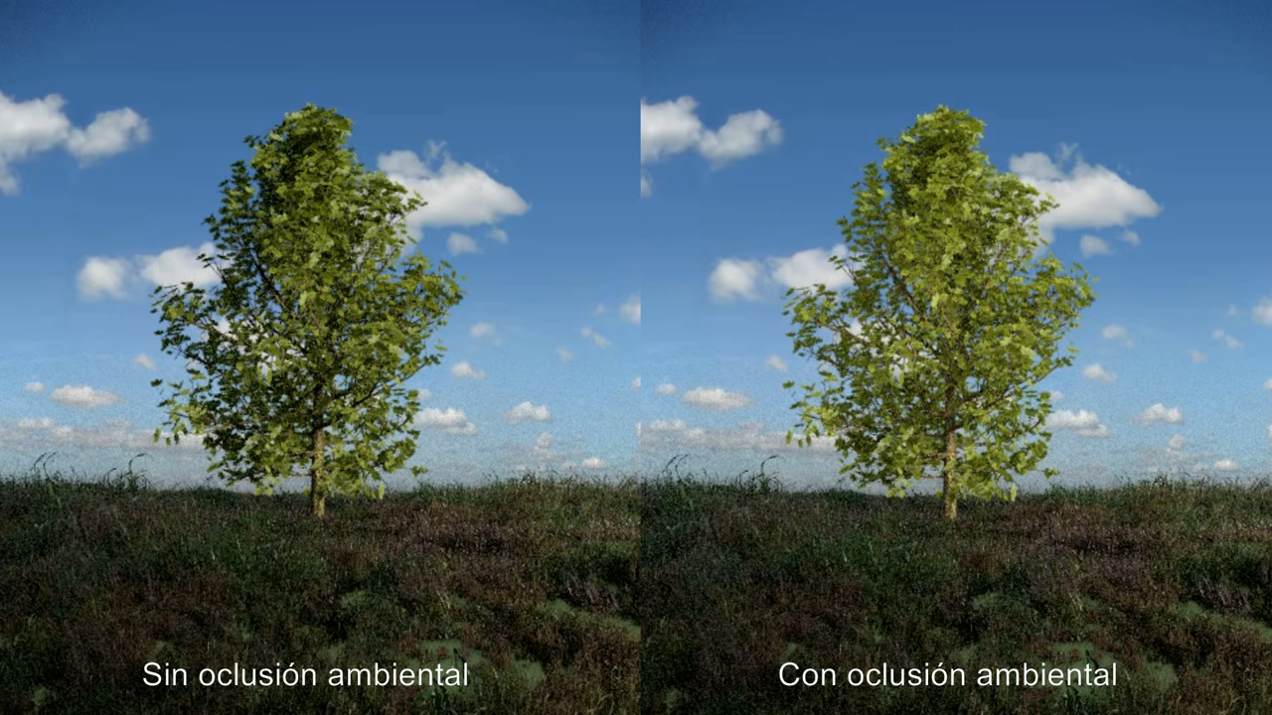

Slide 40
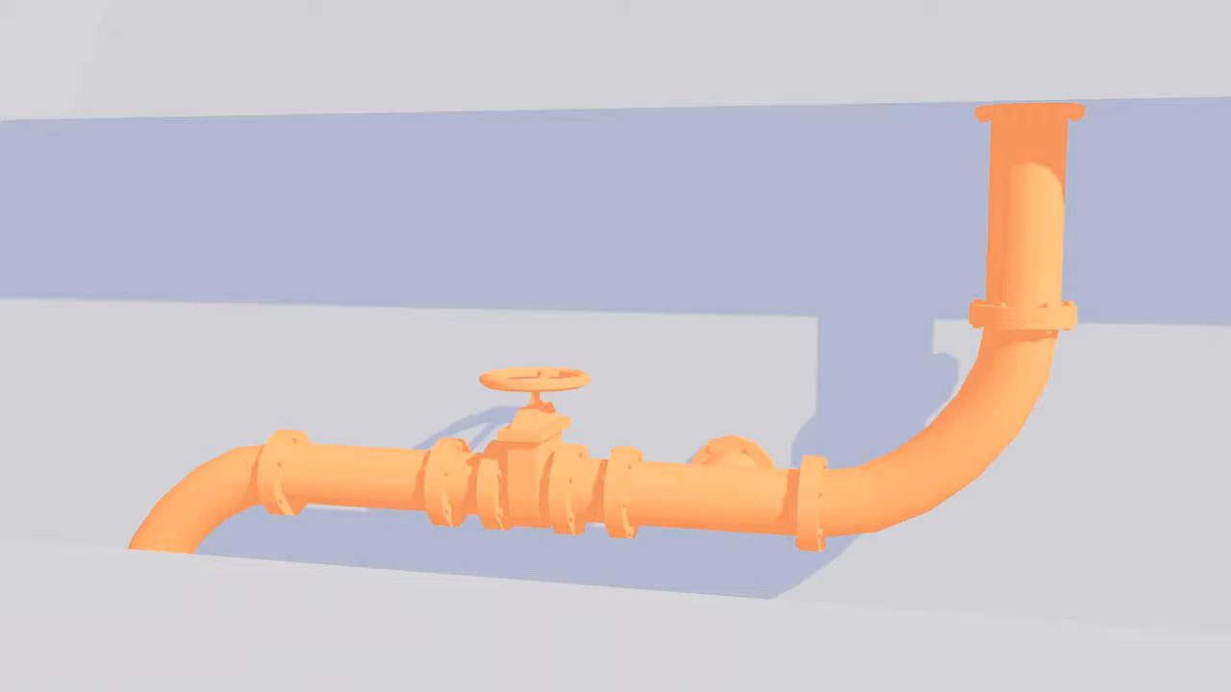

Slide 41
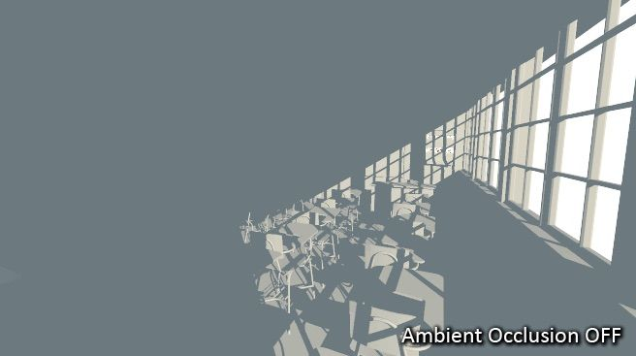
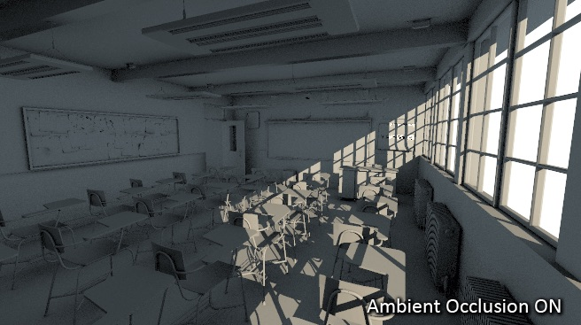

Slide 42
What Is Ambient Occlusion?
A point on a plane surface can receive light from a full 180-degree hemisphere around that point and above the plane. In another example, a point in a room’s corner, as shown in Figure 1.2.1, could receive a smaller amount of light than a point in the middle of the floor, since a greater amount of its “upper hemisphere” is occluded by the nearby walls.
The resulting effect is a crude approximation of global illumination that enhances depth in the scene by shrouding corners, nooks, and crannies in a scene.

Slide 43
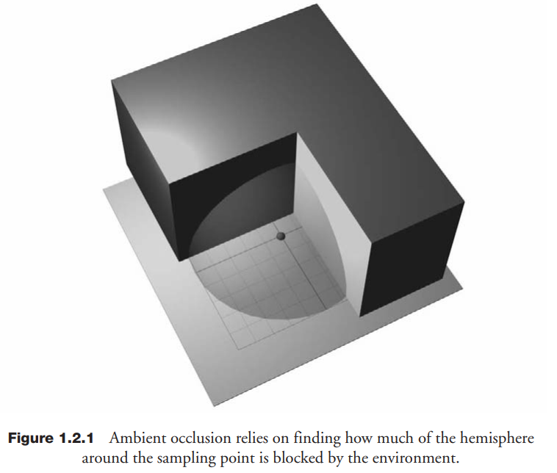

Slide 44
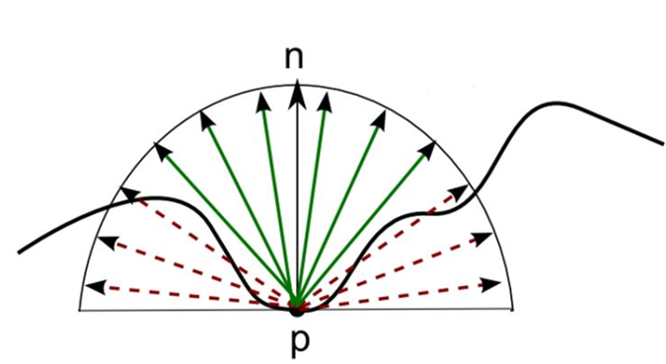
What Is Ambient Occlusion?
In most cases, ambient occlusion is calculated by constructing a hemisphere of rays emanating from a point on the surface in all directions and then checking them for the intersection with other objects. Rays that reach the background or sky increase the brightness of the surface, while the rays that cross other objects do not add brightness.

Slide 45
What Is Ambient Occlusion?
Although the global illumination problem has been vastly simplified through this approach, it can still be prohibitively expensive to compute in real time. Every point on every scene surface needs to cast many rays around it to test whether an occluding object might be blocking the light, and an ambient occlusion term is computed based on how many rays were occluded from the total amount of rays emitted from that point.
Performing arbitrary ray intersections with the full scene is also difficult to implement on graphics hardware. We need further simplification.

Slide 46
Screen Space Ambient Occlusion
The basics behind screen-space ambient occlusion are simple: for each fragment on a screen-filled quad we calculate an occlusion factor based on the fragment's surrounding depth values. The occlusion factor is then used to reduce or nullify the fragment's ambient lighting component. The occlusion factor is obtained by taking multiple depth samples in a sphere sample kernel surrounding the fragment position and compare each of the samples with the current fragment's depth value. The number of samples that have a higher depth value than the fragment's depth represents the occlusion factor.
If the neighbor’s depth is behind the point being tested for occlusion, then no occlusion is assumed to occur. All of these calculations can be performed using the screen space buffer of normals and depths, hence the name Screen Space Ambient Occlusion (SSAO).

Slide 47
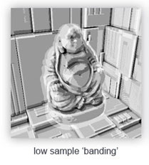
Screen Space Ambient Occlusion

Slide 48
Screen Space Ambient Occlusion
At first glance, this may seem like a gross oversimplification. After all, the depth buffer doesn’t contain the whole scene, just the visible parts of it, and as such is only a partial reconstruction of the scene. For example, a point in the background could be occluded by an object that is hidden behind another object in the foreground, which a depth buffer would completely miss. Thus, there would be pixels in the image that should have some amount of occlusion but don’t due to the incomplete representation we have of the scene’s geometry.
It turns out that these kinds of artifacts are not especially objectionable in practice. The eye focuses first on cues from objects within the scene, and missing cues from objects hidden behind one another are not as disturbing. Furthermore, ambient occlusion is a low-frequency phenomenon; what matters more is the general effect rather than specific detailed cues.

Slide 49
Screen Space Ambient Occlusion
From this brief overview, we can outline the steps we will take to implement Screen Space Ambient Occlusion.
We will first need to have a depth buffer and a normal buffer at our disposal from which we can extract information.
From these screen space maps, we can derive our algorithm. Each pixel in screen space will generate a corresponding ambient occlusion value for that pixel and store that information in a separate render target. For each pixel in our depth buffer, we extract that point’s position and sample n neighboring pixels within the hemisphere aligned around the point’s normal.
The ratio of occluding versus non-occluding points will be our ambient occlusion term result.
The ambient occlusion render target can then be blended with the color output from the scene generated afterward.

Slide 50
Deferred shading..
Deferred shading costs are independent of scene complexity. This is because deferred shading techniques store geometry information in textures, often called G-buffers, replacing geometry processing with pixel processing.
Deferred shading techniques start by rendering the scene into a G-buffer, which is typically implemented using multiple render targets to store geometry information, such as positions, normals, and other quantities instead of final shading results.
Next, deferred shading systems render a screen-aligned quad to invoke a pixel shader at all pixels in the output image. The pixel shader retrieves the geometry information from the G-buffer and performs shading operations as a post process.

Slide 51
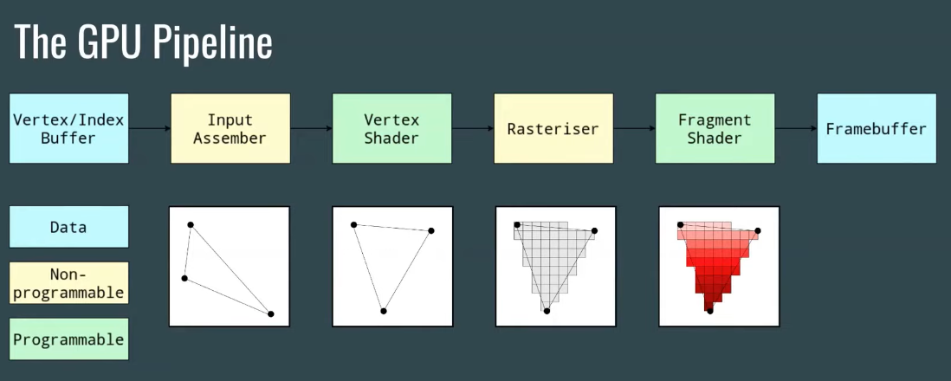
Deferred shading..

Slide 52
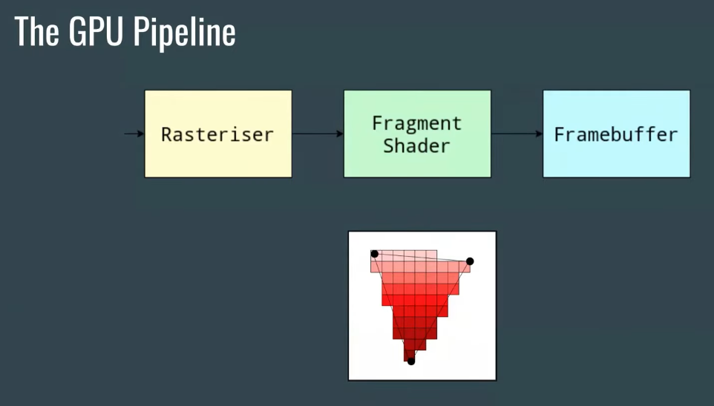
Deferred shading..

Slide 53
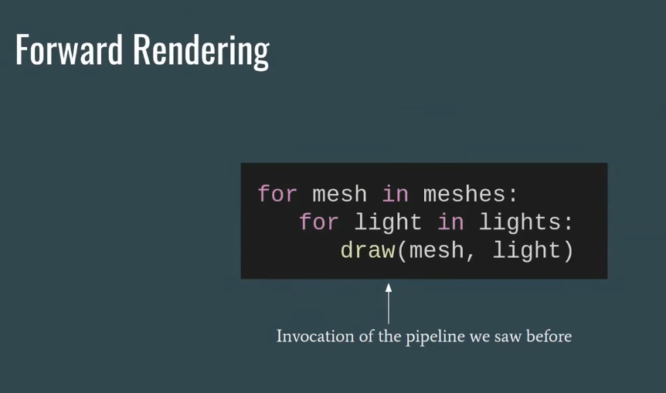
Deferred shading..

Slide 54
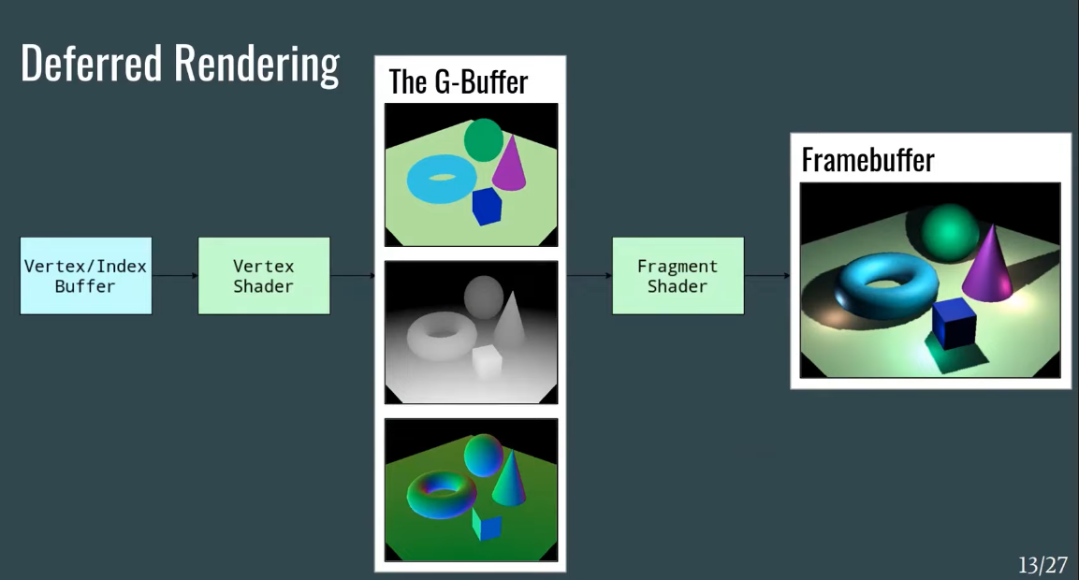

Slide 55
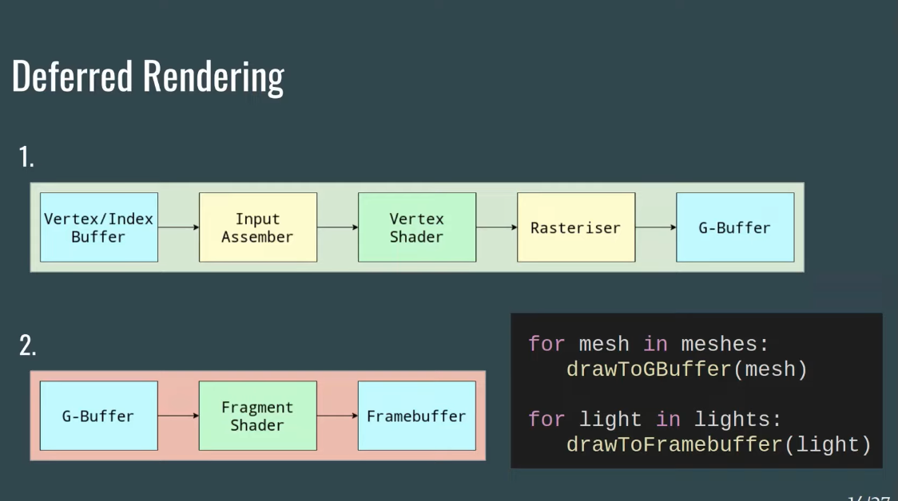

Slide 56
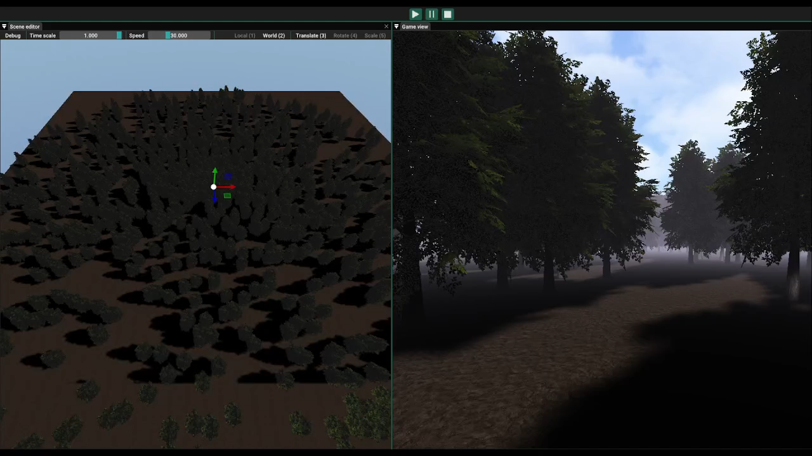
View Frustum Culling

Slide 57
View Frustum Culling
Is a way how to limit your GPU usage thanks to a technical name's the frustum culling. This technique is simple to understand. Instead of sending all information to your GPU, you will sort visible and invisible elements and render only visible elements. Thanks to this technique, you will earn GPU compute time.

Slide 58
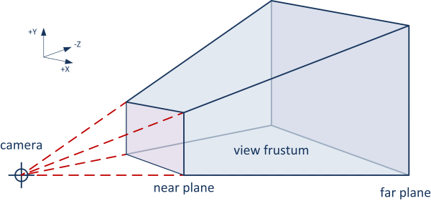
View Frustum Culling
frustum is a portion of a solid like a cone or pyramid. The frustum is usually used in game engine to speak about the camera frustum. Camera frustum represents the zone of vision of a camera. Without limit, we have a pyramid but with near and far we have a frustum.
To mathematically represent a frustum, 6 planes are needed: near, far, right, left top and bottom planes. So, an object is visible if it is forward or on the 6 planes

Slide 59
Link to video
https://www.youtube.com/watch?v=pkF8Nd8lMs4

